Slide 1
tableau project 1
File created on: 1/26/2025 4:31:34 PM

Slide 2
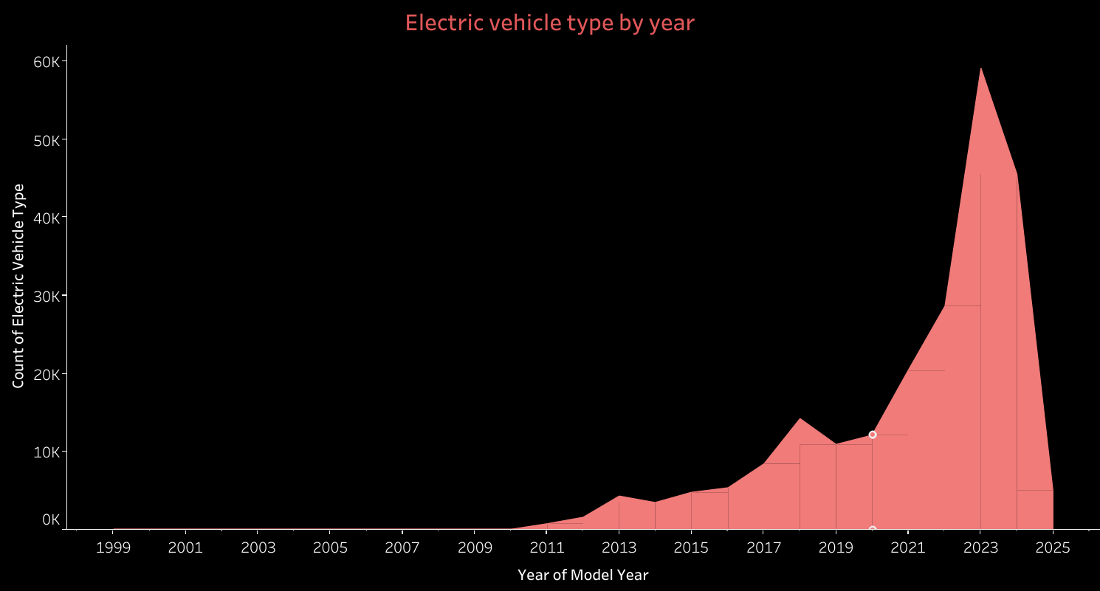

Slide 3
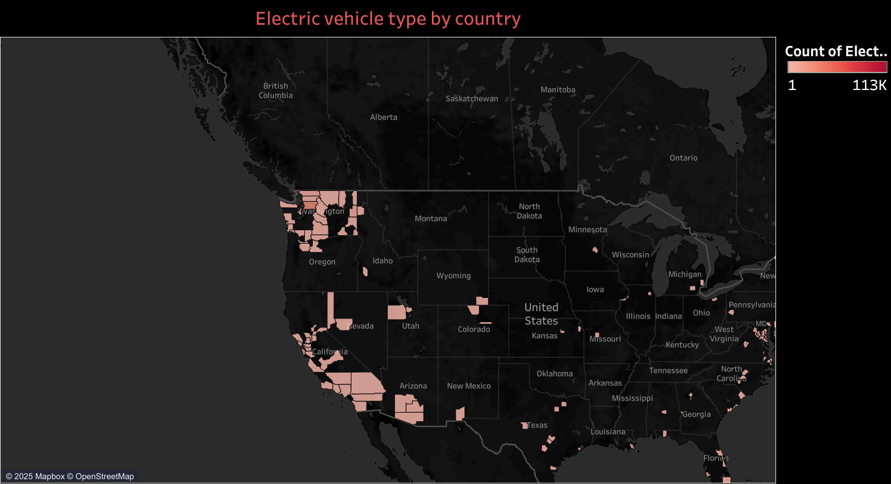

Slide 4
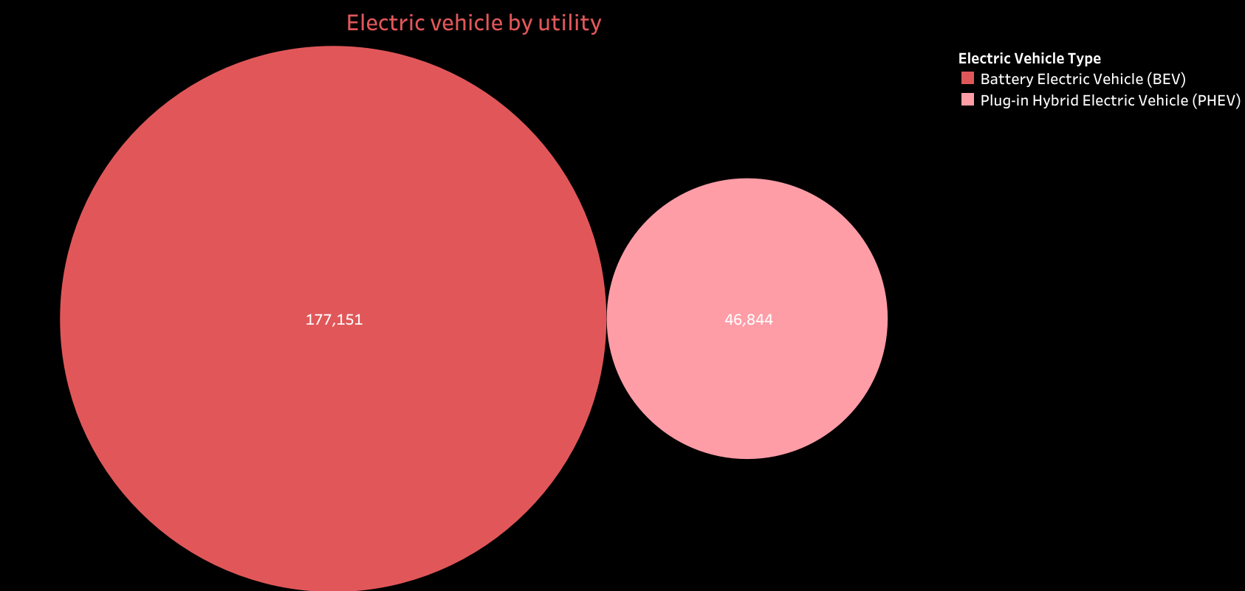

Slide 5
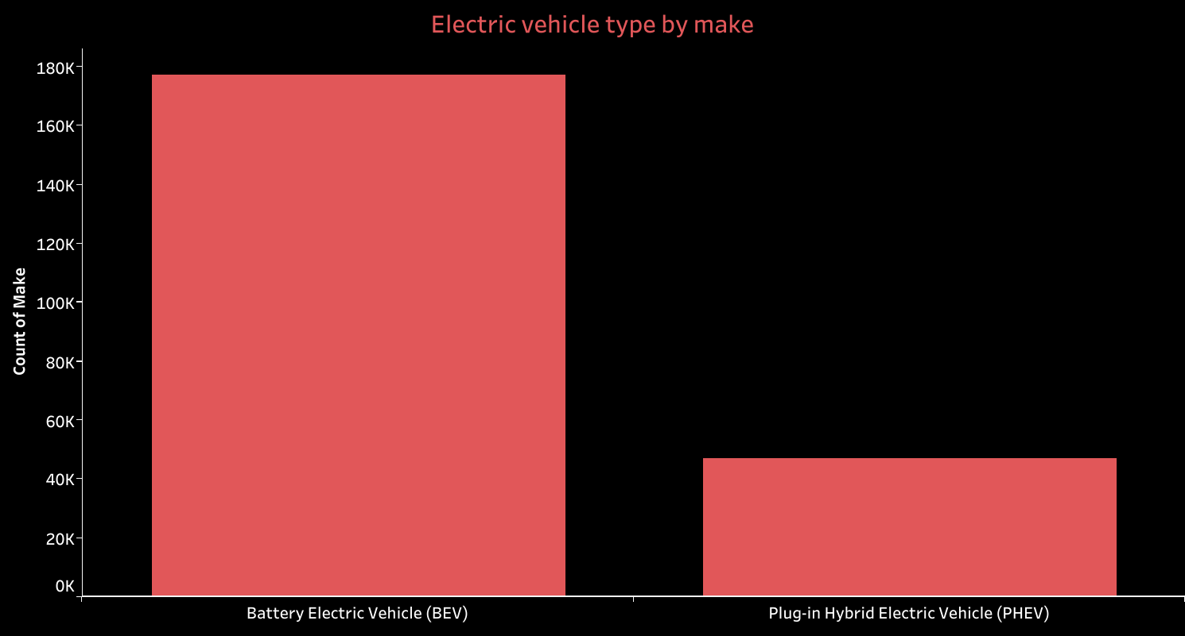

Slide 6
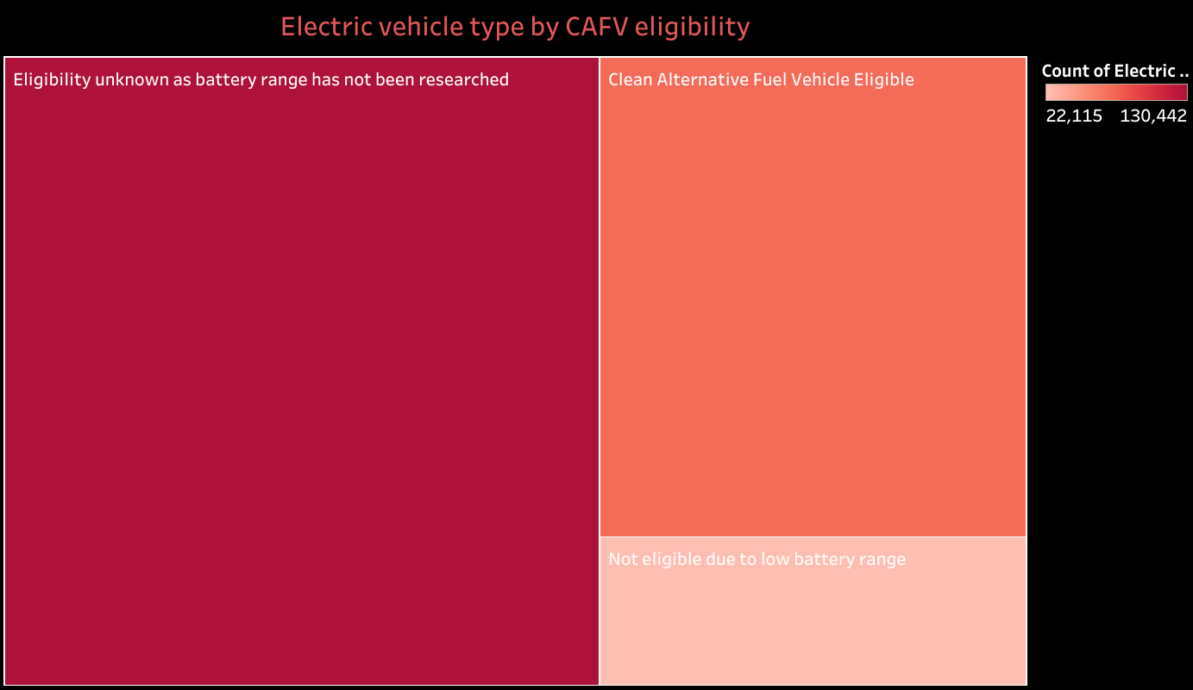

Slide 7


Slide 8
